Slide 1

4th International LNG Summit
Oslo, 18 June 2019
Welcome to Summit
Barbara Jinks, GIE

Slide 2


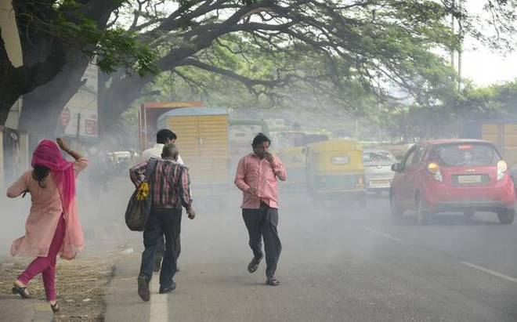
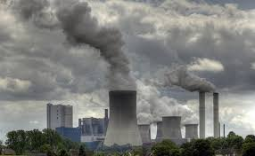
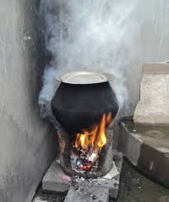
LNG has clear benefits over other fuels

Slide 3
Fuel alternatives - LNG

Slide 4
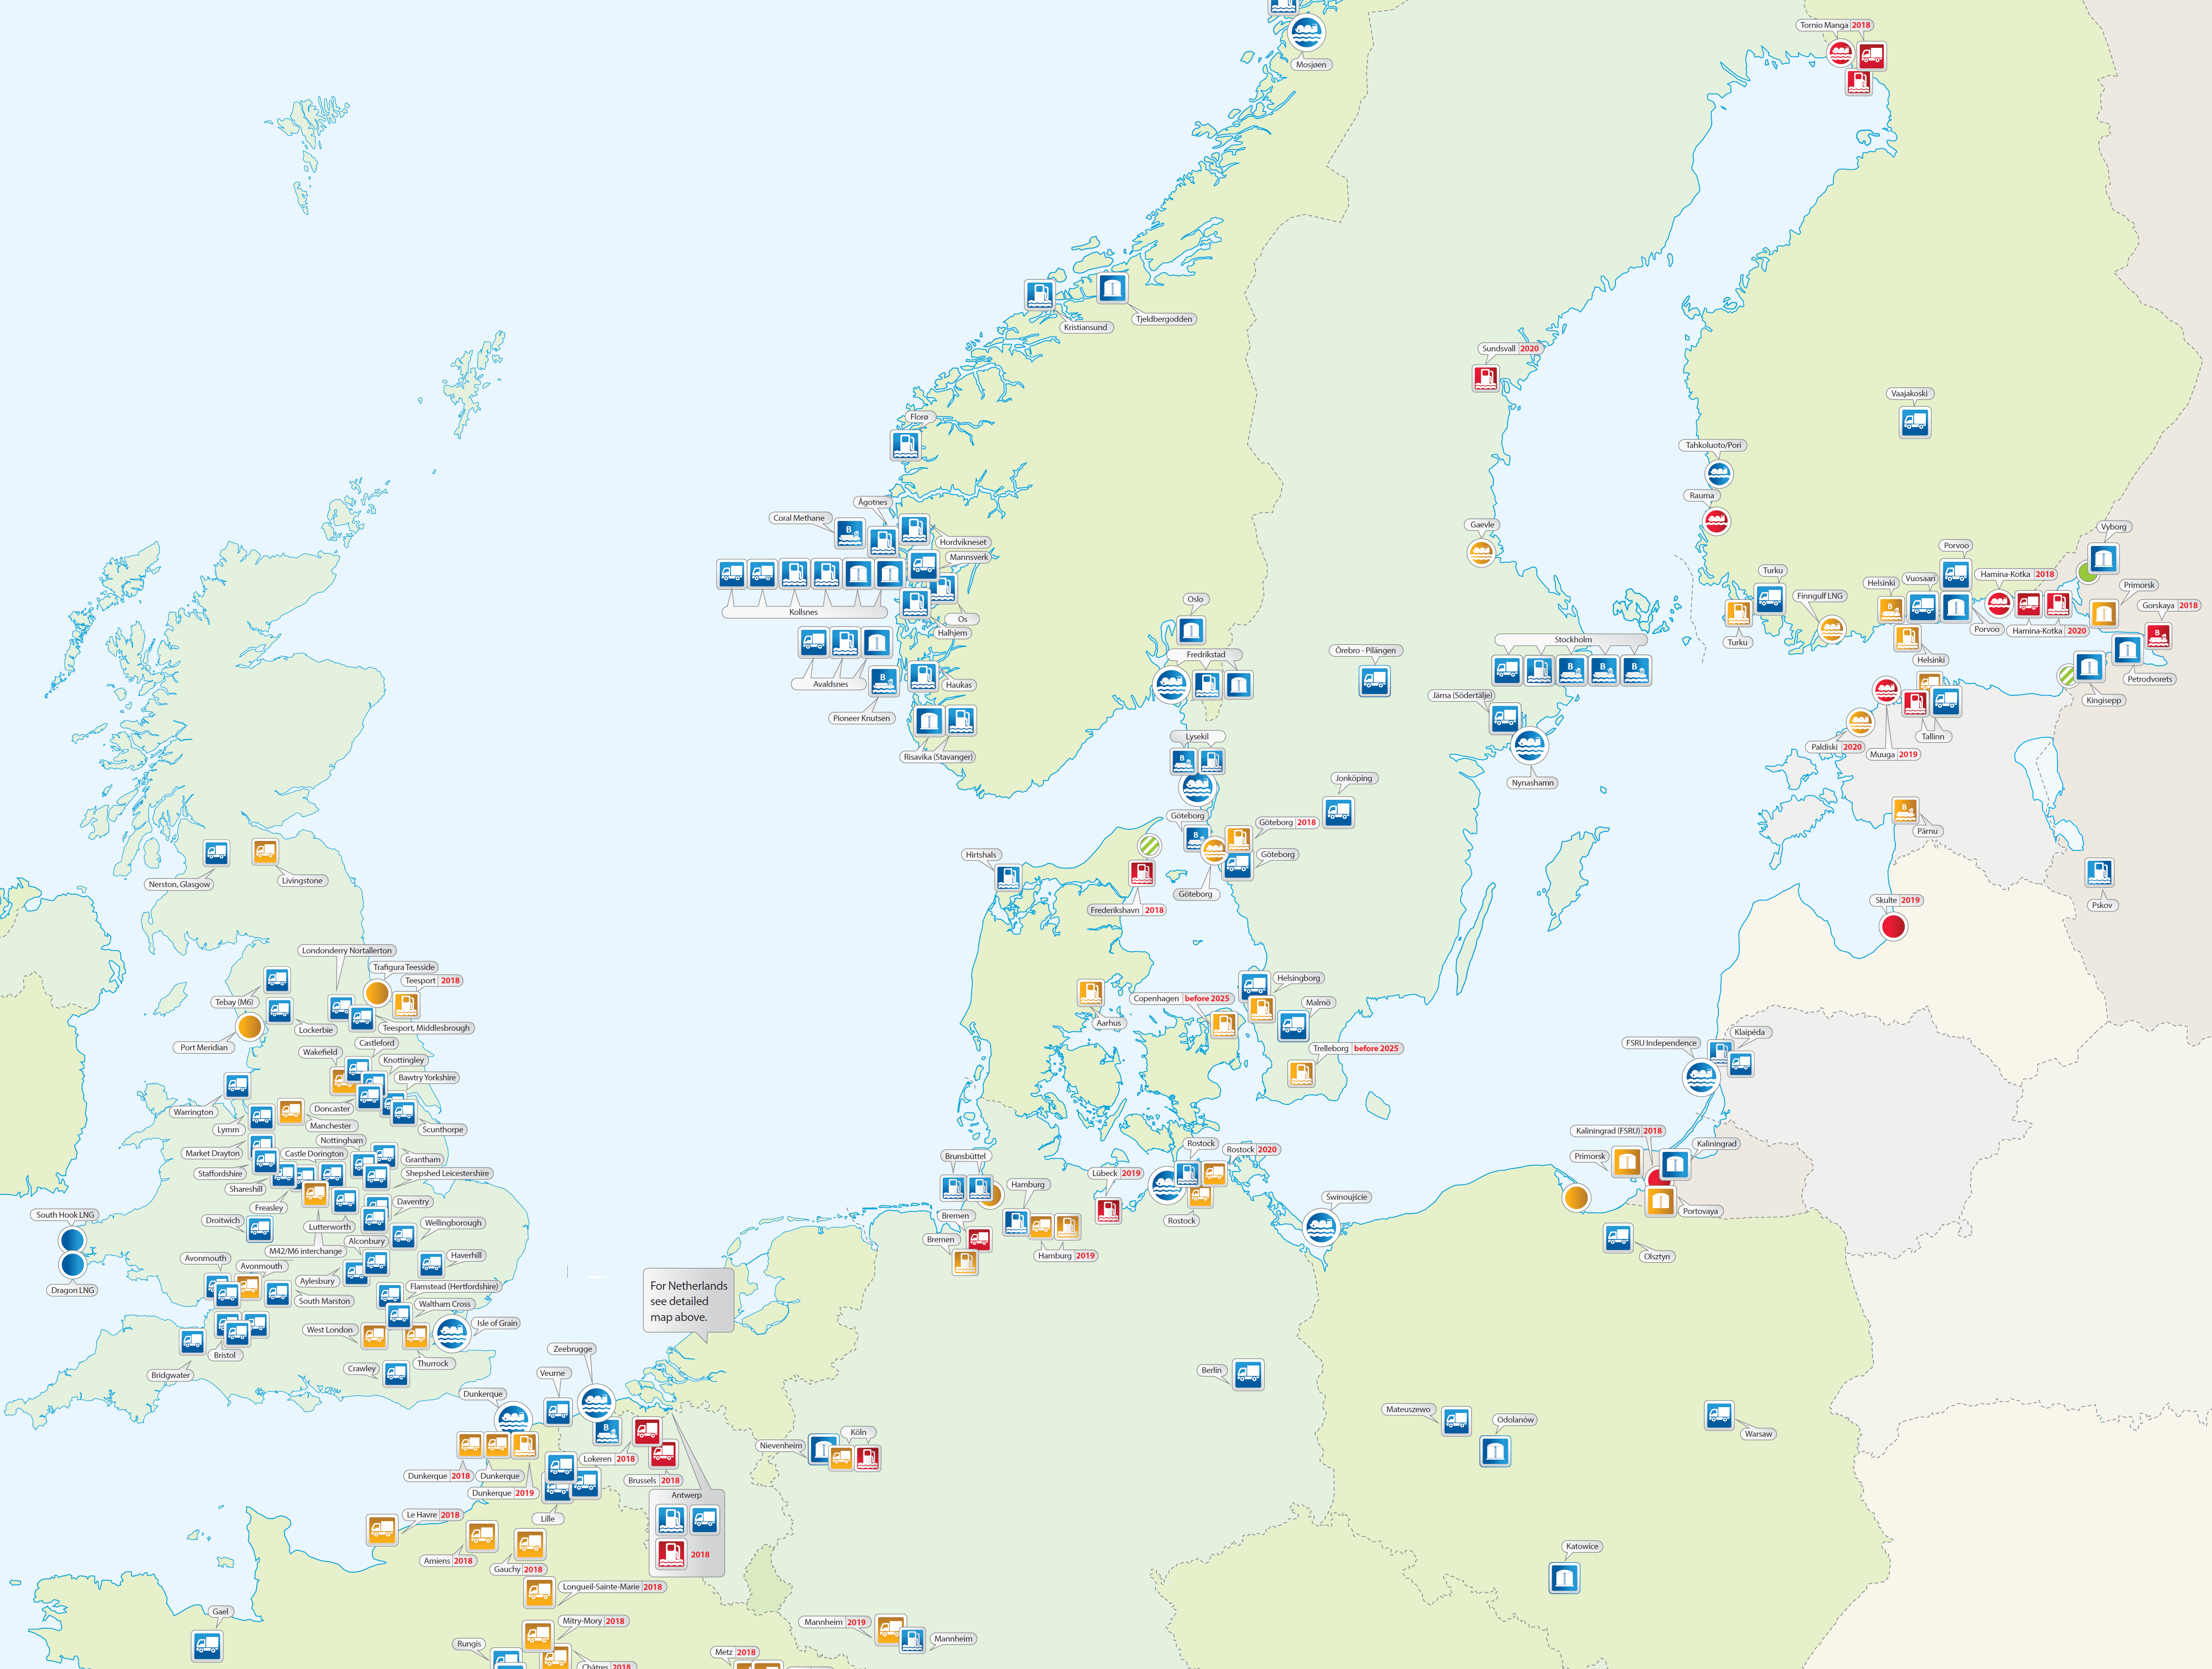
LNG infrastructure in EU
Extensive existing assets - ready for growth
GIE Small-scale LNG map 2018
Find it here:
https://www.gie.eu/index.php/gie-publications/maps-data/gle-sslng-map

